Slide 1
The Impact of Virtual Reality in Today’s World
Natasha Nieves

Slide 2
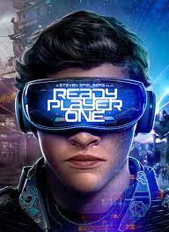
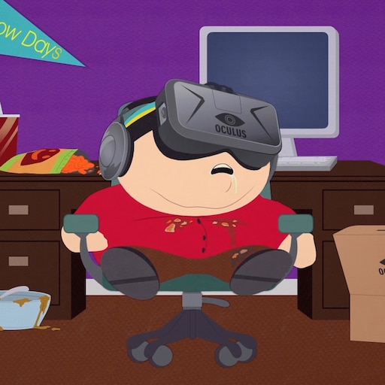
Virtual Reality
VR has become increasingly popular in recent years
Provides an escape from everyday life, transporting users to different worlds
Widely used for gaming, education, and medical purposes
VR immerses users in a three-dimensional sensory environment
Ability to block out physical surroundings enhances belief in the virtual world
Utilizes interactive headsets and body suits for a deeper VR experience
Advanced technology incorporates motion sensors into headgear and bodysuits
Motion sensors pick up users' surroundings and adjust the virtual setting accordingly

Slide 3
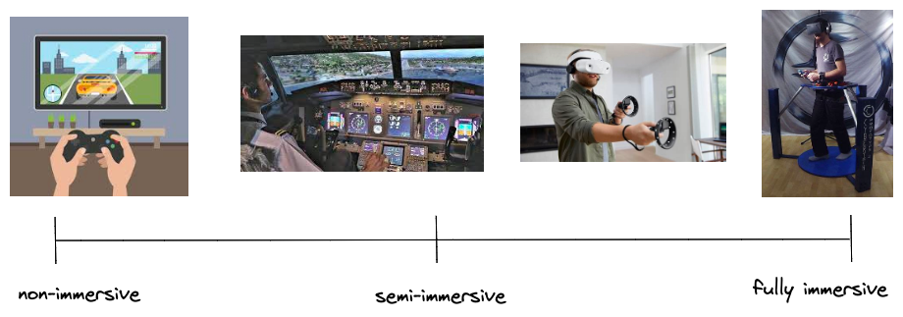
Three Types of Virtual Reality
Three main types of VR technologies:
Fully Immersive VR uses a stereoscopic 3D display and input tracking for a believable experience
Non-Immersive VR provides virtual experiences through a computer with limited direct interaction
Semi-Immersive VR allows interaction with the virtual environment without physical interaction

Slide 4
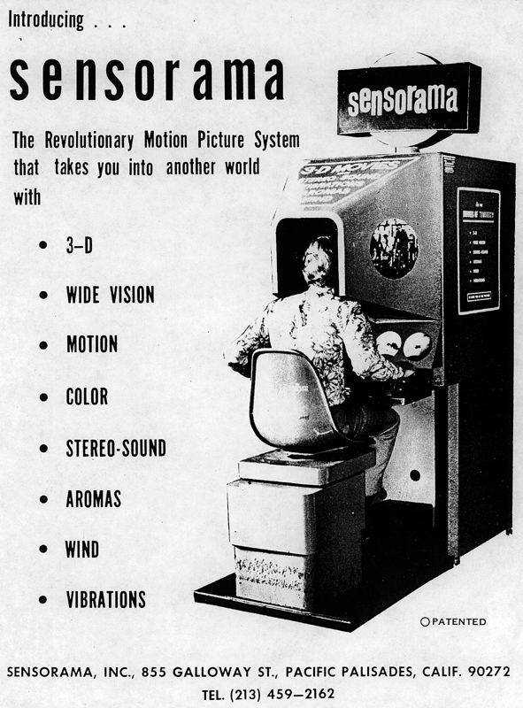
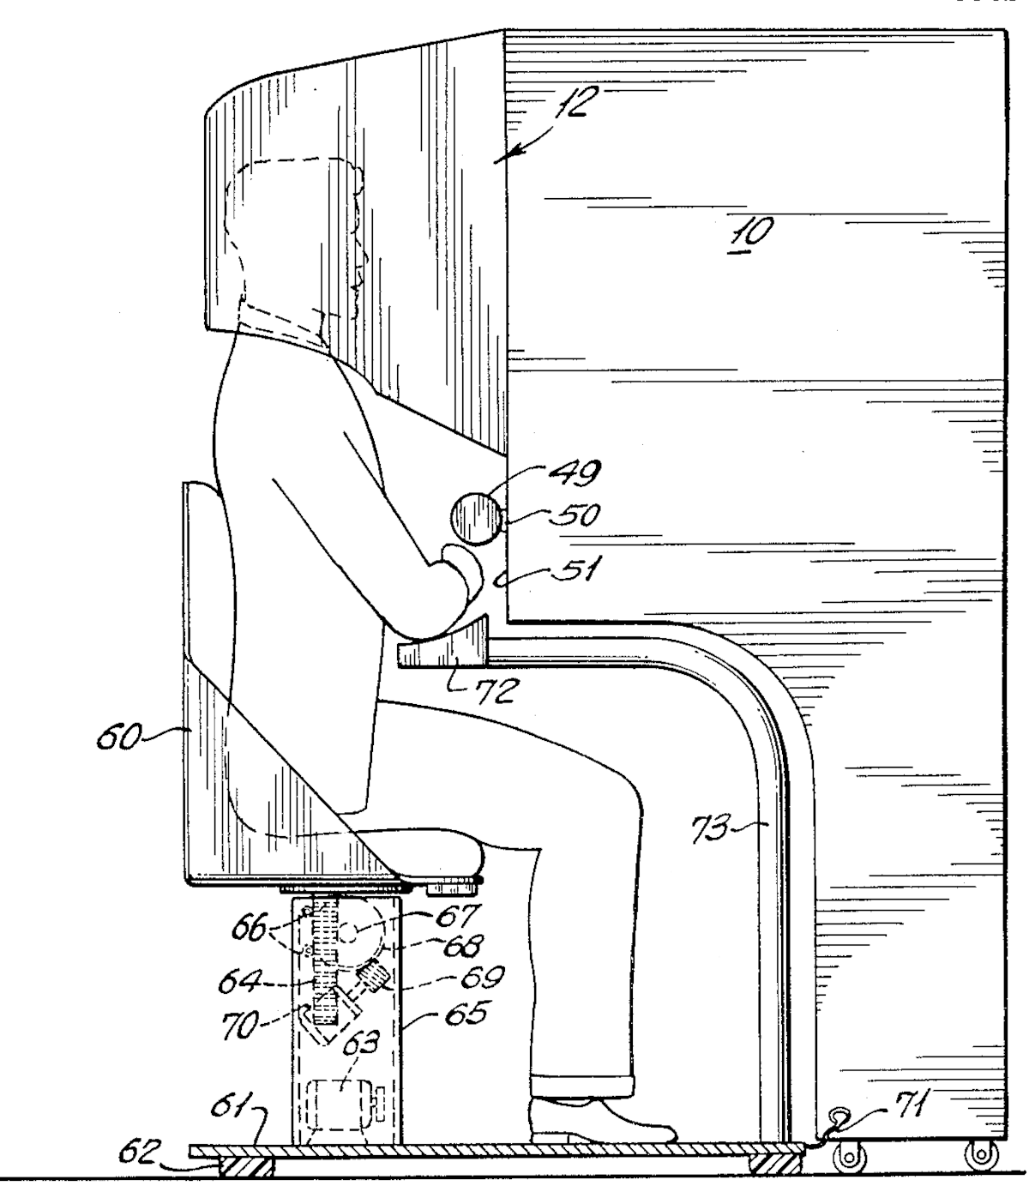
History and Gaming
First virtual reality attempt was mid 1950s with Morton Heilig’s Sensorama Simulator
Features stereoscopic-3D screen, vibrating chair, 6 featured scenes
Enhance users’ senses, not just visual

Slide 5
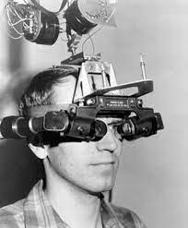
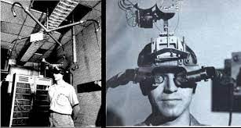
History and Gaming (cont)
In 1968 computer scientist Ivan Sutherland and his student Bob Sproull came out with the first head mounted display VR
Known as the Sword of Damocles
Connected to a computer, allowed a wider display when users turned their heads

Slide 6
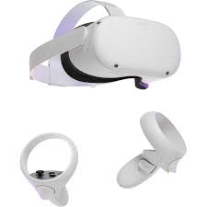
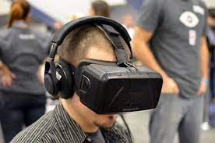
History and Gaming (cont)
First Oculus Rift prototype invented by Palmer Luckey in 2010
In 2014 Mark Zuckerberg bought Oculus Rift for $2 billion.
Zuckerberg's vision for VR: New communication platform.
Oculus Rift was discontinued but was reintroduced as the Meta Quest VR headset, released in 2023.

Slide 7
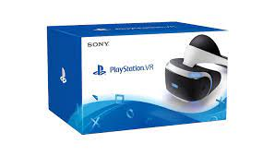
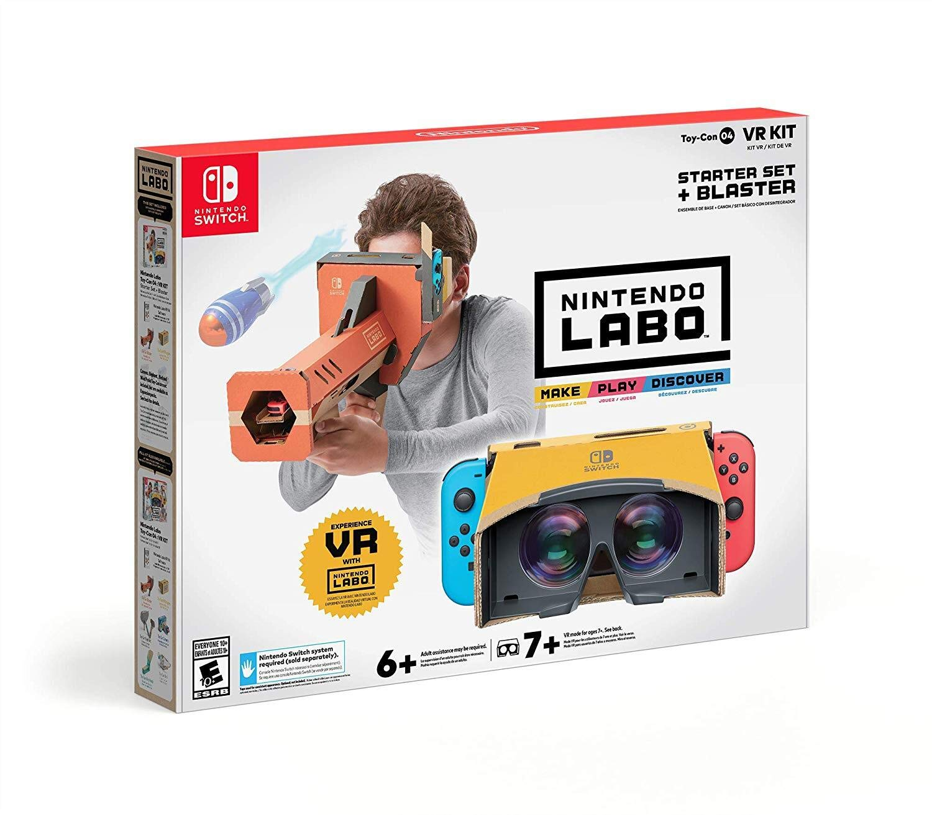
History and Gaming (cont)
VR is not the first thought when people think about video games
Slowly, more companies are hopping on the VR trend
Sony's PlayStation VR for PS4 introduced in 2016
Features: 360-degree vision, 3D audio, built-in microphone
Move Motion controllers enhance immersion.
PS VR game controller for precise aiming and haptic feedback.
Even Nintendo came out with a VR
Nintendo Labo and OIVO VR headset for Nintendo Switch.
Wide variety of games available for both devices.

Slide 8
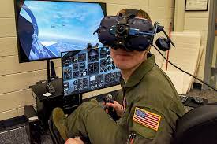
Education
VR not only transforming gaming but also the education system
Kiara Miller's 5 benefits of VR in teaching: Increased engagement, immersive learning, higher retention, experiential learning, inclusivity
Use of VR helps improve student engagement
S. Piovesan et. al cites Clark (2006): VR makes learning interesting and fun, enhances motivation and attention.
Reduces costs even when the simulation is expensive
Studies show VR positively affects academic performance
VR used in various fields: aviation, military, architecture, mathematics, and science

Slide 9
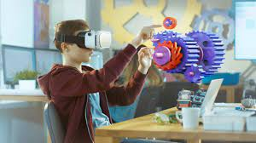
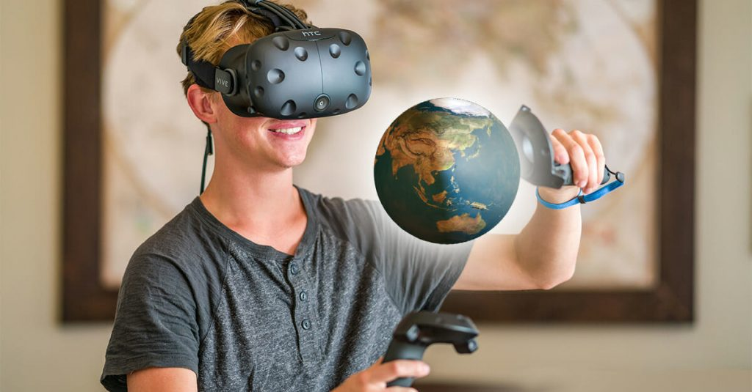
Education (cont)
Enhances the overall quality of education (Bayraktar & Kaleli, 2007 as cited in SARIOĞLU1 & GİRGİN, 2020).
A 2020 study on 6th graders found significant effects on achievement and attitudes toward the course due to VR technology (SARIOĞLU1 & GİRGİN, 2020).

Slide 10
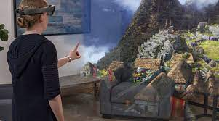

Education (cont)
VR extends to history and social studies
Allows students to virtually travel to different places, such as space, cultural, and historical monuments
2018 study by Mary Michelle Bowen assessed VR's impact on middle school students' social studies courses
Students used the Google Expeditions app on their smartphones for virtual field trips
Experiencing content in a real-world context enhances understanding and connection to the material

Slide 11
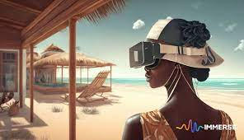


Education (cont)
VR field trips provide a cost-effective alternative to physical field trips
Many schools face budget constraints that limit traditional field trips
VR offers opportunities to explore and learn about diverse locations and cultures, regardless of budget limitations

Slide 12
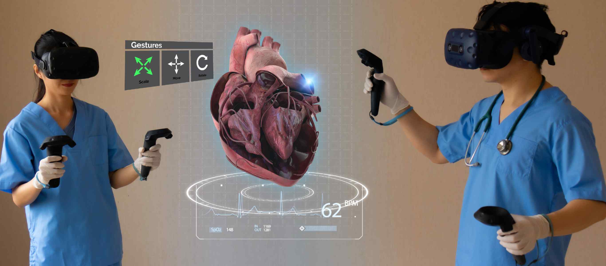
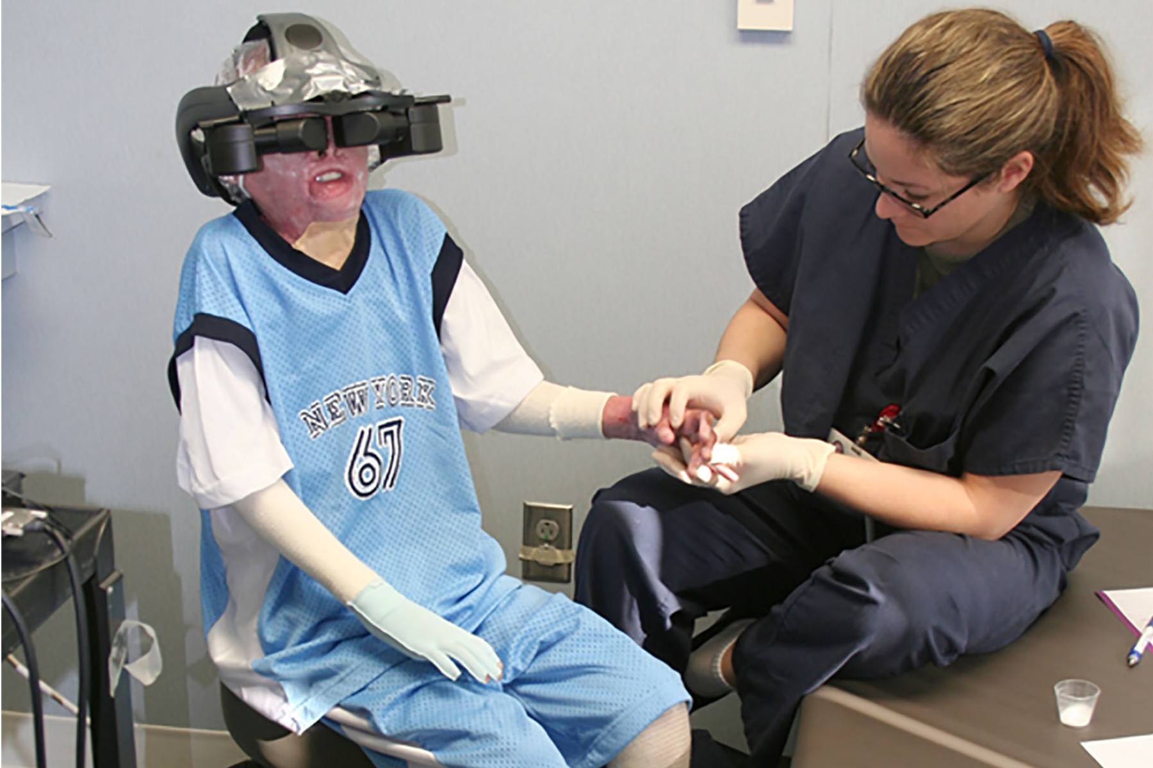
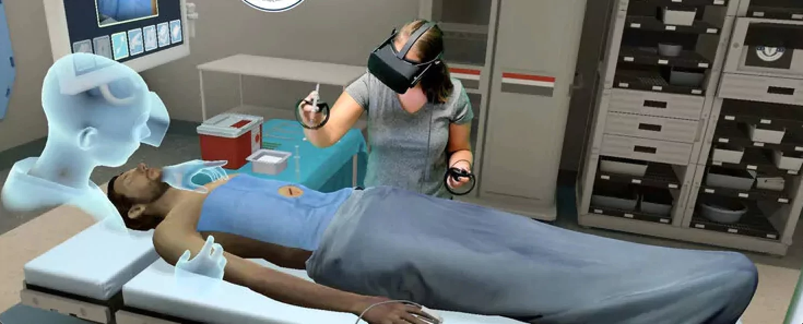
Medical Field
VR is changing the future of surgeries and telemedicine
Application areas in healthcare: surgery, pain management, rehabilitation, mental health, and more
VR's role in surgical training for residents
VR used by surgical residents to practice and gain confidence
Orthopedic surgery residents utilize VR for various applications
Studies show significant improvements in surgical performance using VR platforms

Slide 13
Medical Field (cont)
Growing mental health issues post-pandemic
Virtual reality games as coping mechanisms
Study by Federica Pallavicini and Alessandro Pepe: VR games boost positive emotions and lower anxiety
Advancements in VR technology: immersive educational experiences, hyper-realistic VR, social VR platforms, AI integration, business adoption
The impact of VR on education and academic success

Slide 14
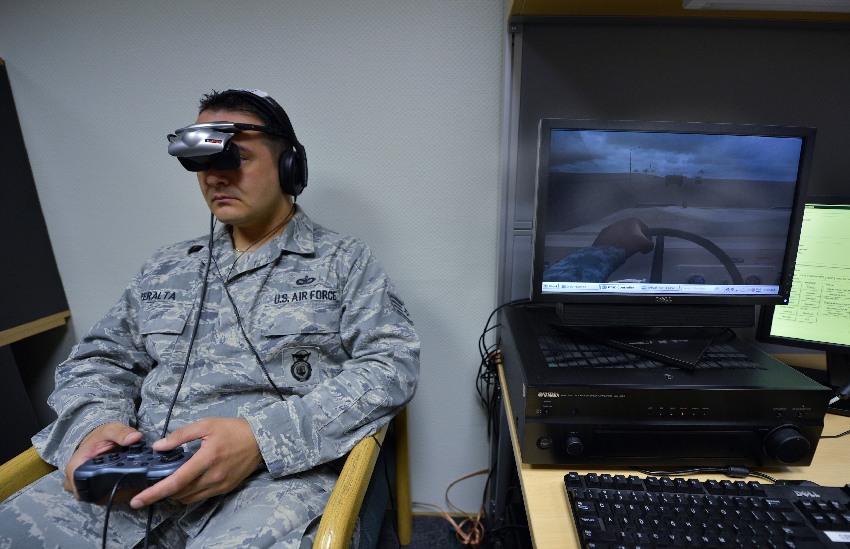
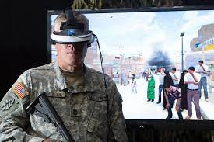
Medical Field (cont)
VR's role in healthcare: treating patients with PTSD and mental illnesses
Immersion in a different environment boosts happiness
Exposure therapy in a safe and controlled VR environment

Slide 15
Conclusion
VR technology continues to advance and make a lasting impact in various fields
Its significance in shaping the future of technology
VR's influence in the gaming industry and its value
VR's pervasive impact on today's world across all sectors

Slide 16
References

